Slide 1
Master
Testing Slides

Slide 2
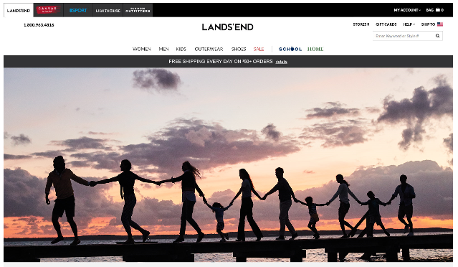
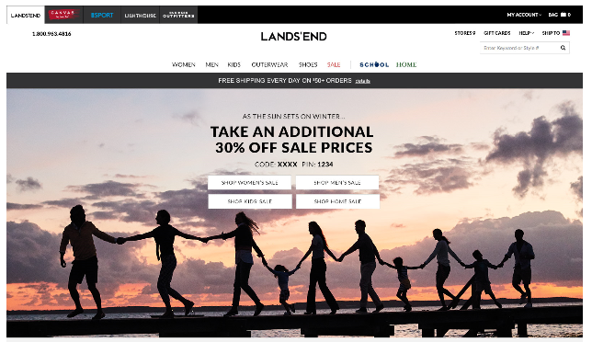
LE.com Offer Test: January 23rd 2017 Objective: Determine impact of Promotion over a No Offer Control
LE.com Promotion drove +23% Increase in Orders, & -4% Decrease in Margin Dollars
Control
No Offer
TEST
Additional 30% Off Sale & Clearance
Demand: $454K
Profit Dollars: $154K
Margin Rate: 58%
Orders: 4,426
AOV: $102.20
Demand: $536K +18%
Profit Dollars: $148K - 4%
Margin Rate: 50% - 720 Bps
Orders: 5,458 +23%
AOV: $97.70 - 4%
Demand Lift
+18%

Slide 3
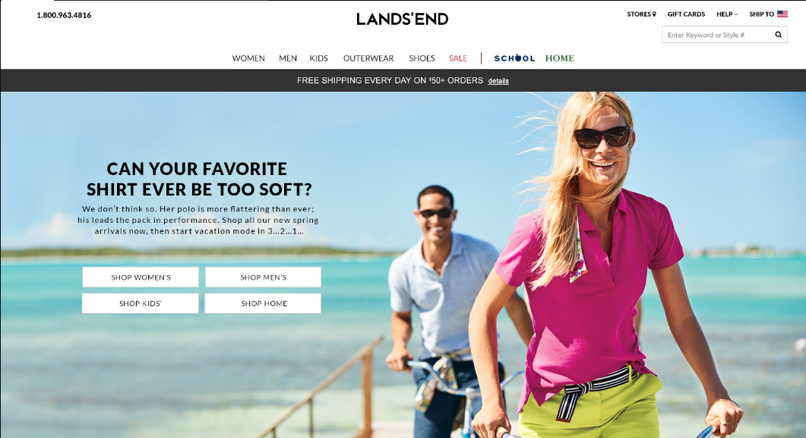
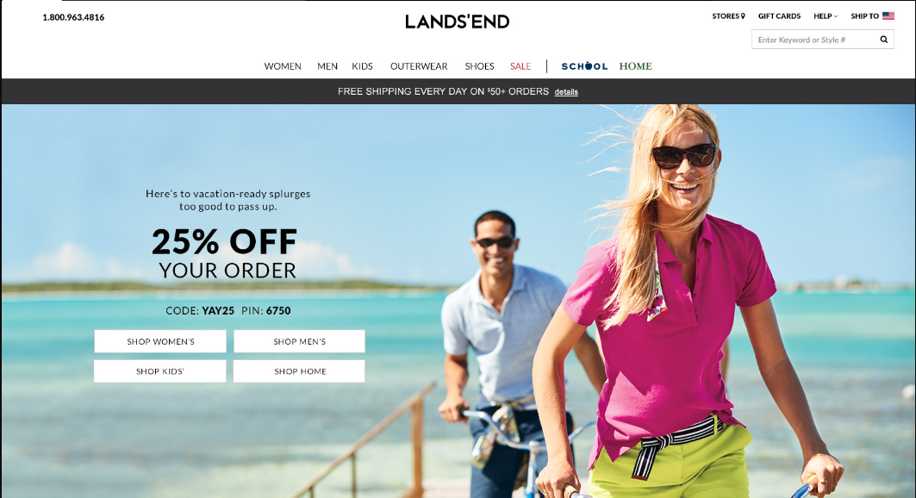
LE.com Offer Test: January 31st 2017 Objective: Determine impact of Promotion over a No Offer Control Note: Profit Dollars Increase was NOT Statistically Significant
LE.com Promotion drove +16% Increase in Orders, & +3% Increase in Margin Dollars
Control
No Offer
TEST
25% Off Order
Demand: $669K
Profit Dollars: $220K
Margin Rate: 51%
Orders: 6,375
AOV: $104.90
Demand: $752K +12%
Profit Dollars: $227K +3%
Margin Rate: 48% - 300Bps
Orders: 7,410 +16%
AOV: $101.20 - 4%
Demand Lift
+12%

Slide 4
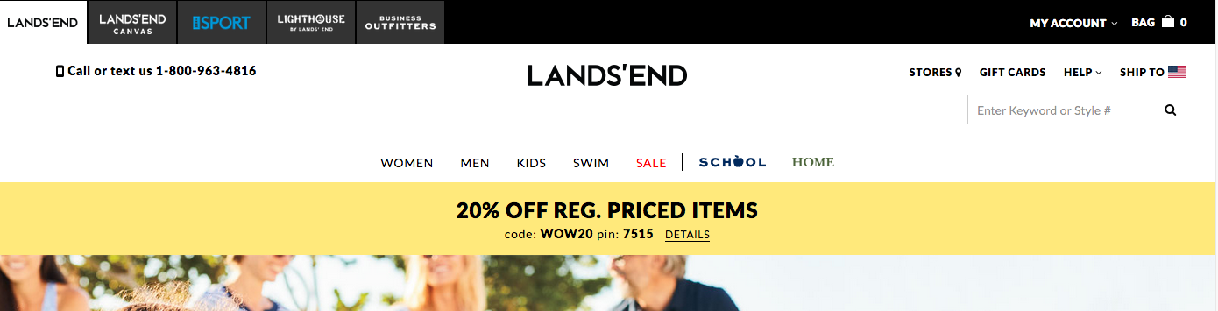
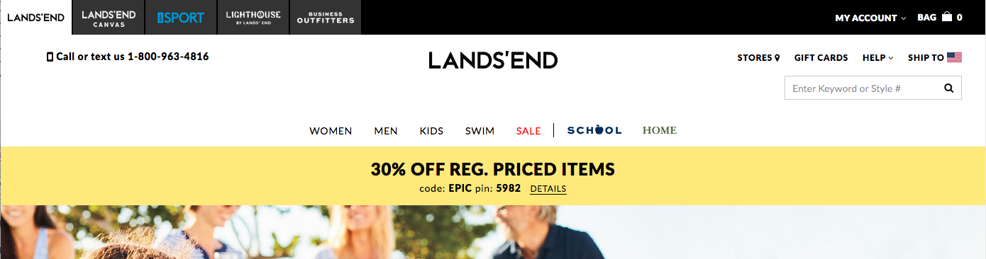
LE.com Offer Test: 3.10.17 – 3.13.17 Objective: Determine impact of Promotion Level on Profitability Note: Profit Dollars Increase was NOT Statistically Significant
LE.com Promotion drove +8% Increase in Orders, & +2% Increase in Margin Dollars
Control
20% Off Reg
TEST
30% Off Reg
Demand: $1,453K
Profit Dollars: $498K
Margin Rate: 53%
Orders: 14,088
AOV: $103.10
Demand: $1,535K +6%
Profit Dollars: $508K +2%
Margin Rate: 51% - 130 Bps
Orders: 15,198 +8%
AOV: $100.70 - 2%
Demand Lift
+6%

Slide 5
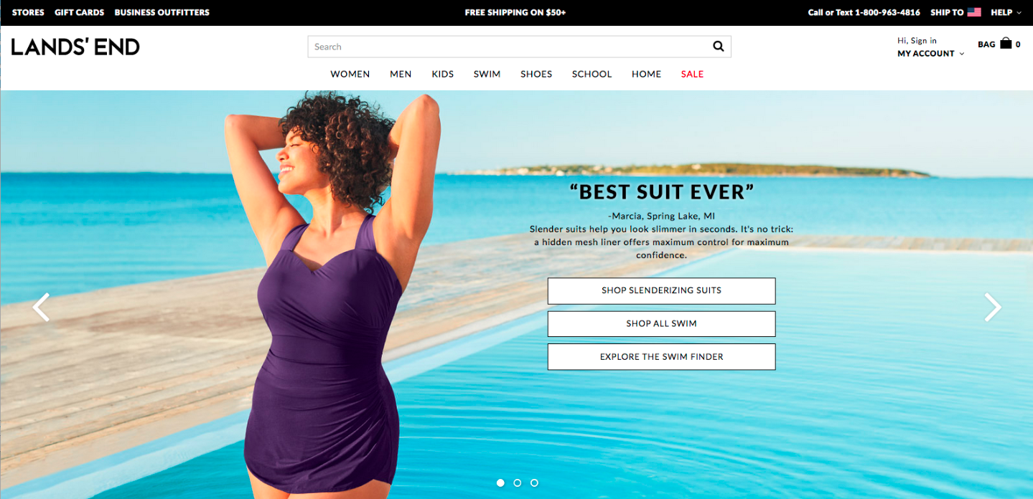
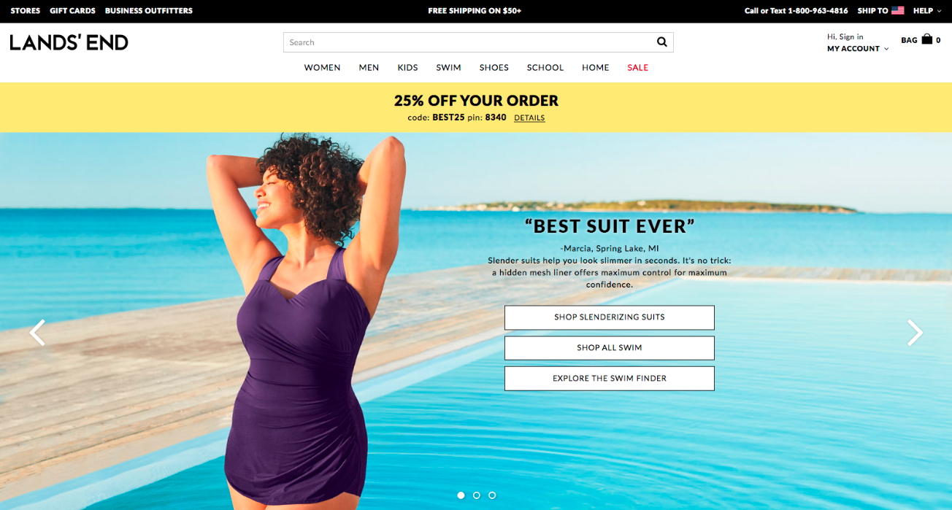
LE.com Offer Test: April 7th – 9th 2017 Objective: Determine impact of Promotion over a No Offer Control Note: Profit Dollars Increase was NOT Statistically Significant
LE.com Promotion drove +11% Increase in Orders, & -1% Decrease in Margin Dollars
Control
No Offer
TEST
25% Off Order
Demand: $779K
Profit Dollars: $242K
Margin Rate: 50%
Orders: 7,747
AOV: $100.50
Demand: $825K +6%
Profit Dollars: $240K - 1%
Margin Rate: 48% - 224 Bps
Orders: 8,594 +11%
AOV: $95.96 - 5%
Demand Lift
+6%
+$45,820 Over 3 Days

Slide 6
LE.com Offer Test: April 27th – May 1st Objective: Determine impact of Promotion over a No Offer Control
LE.com Promotion drove +7% Increase in Orders, & +5% Increase in Margin Dollars
Control
No Offer
TEST
25% Off Reg
Demand: $1,843K
Profit Dollars: $607K
Margin Rate: 52%
Orders: 20,808
AOV: $89.05
Demand: $1,965K +7%
Profit Dollars: $637K +5%
Margin Rate: 52% - 53 Bps
Orders: 22,187 +7%
AOV: $88.67 +0%
Demand Lift
+7%

